Slide 1

Well come to all

Slide 2

Md.Mizanur Rahman
Assistant Teacher
Autgown Government Primary School
Nangolkot, Comilla.

Slide 3

Subject: English
Class: Five
Lesson: Eat Healthy live Healthy.

Slide 4
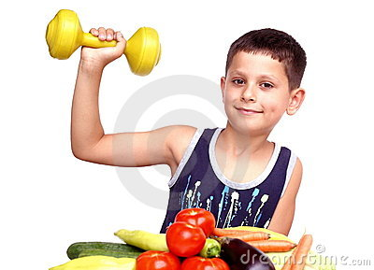


Slide 5
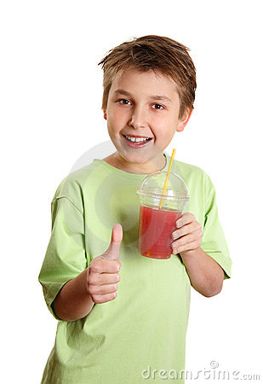

Slide 6
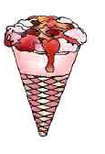
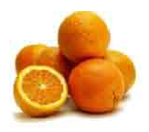
Orange
Ice Cream

Slide 7
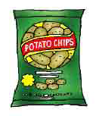
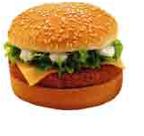
Burger
Chips

Slide 8
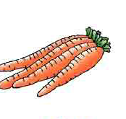

Carrot
Mango

Slide 9
Eat Healthy Live Healthy

Slide 10
By the end of the lesson The learners will be able to
3.1.1 Understand questions asked by the teacher about them.
5.1.1 Read silently with
understanding paragraph .
8.1.1 Make sentences using words and phrases given in the textbook.

Slide 11
Presentation
◊ Open at page 27 and then 28 ( There is a well……..we should eat.)
◊ Teachers Model Reading
◊ Students Silent's Reading
◊ Find out New words

Slide 12

Evaluations:-
1. How do you will be Healthy?
Answer: We will be Healthy by eating Healthy Foods .such as Rice, bread, Chicken,nuts ,milk,fruits and Vegetables.

Slide 13
2. What food we should eat?
Answer: We should eat a good mix of foods.
Write five Sentences about Food From your tropics.

Slide 14


